Slide 1
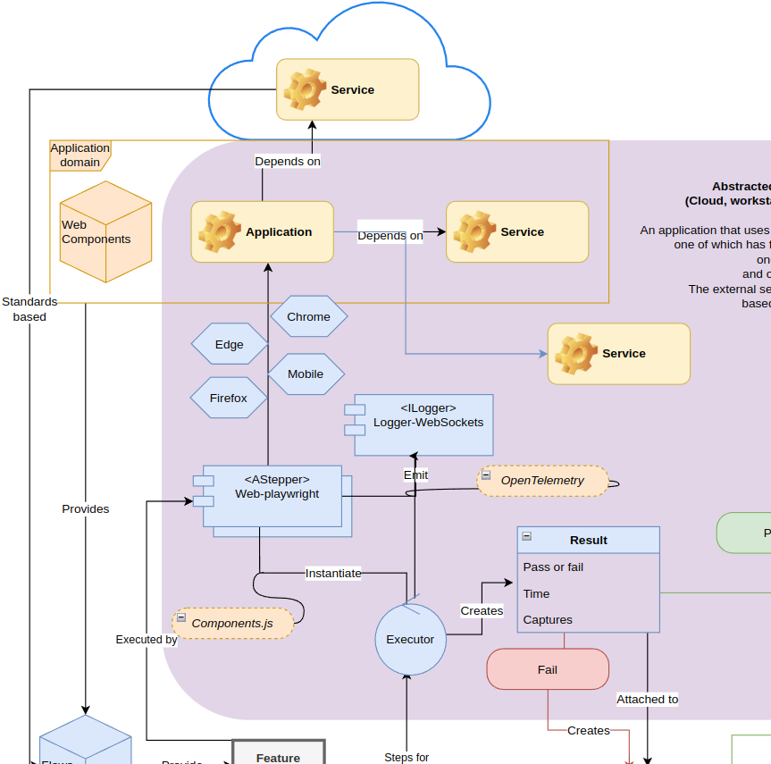
Reviews - dashboard - overview
Oct 27, 2023
Overview diagram

Slide 2
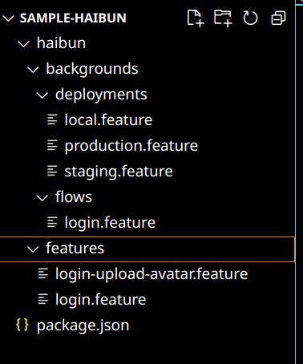
Creating an e2e test suite
Package.json with haibun libs, run scripts
Haibun feature tests & backgrounds
Azure-pipelines file
Include it with versioned code
Feature: Login and upload avatar
Go to the main page
Click the link login
Input {username} for username input
Input {password} for password input
Click the login button
Should be on the account page
Go to the profile page
Upload file “files/avatar.jpg” using upload chooser
Click the button upload
Should see “uploaded file”

Slide 3
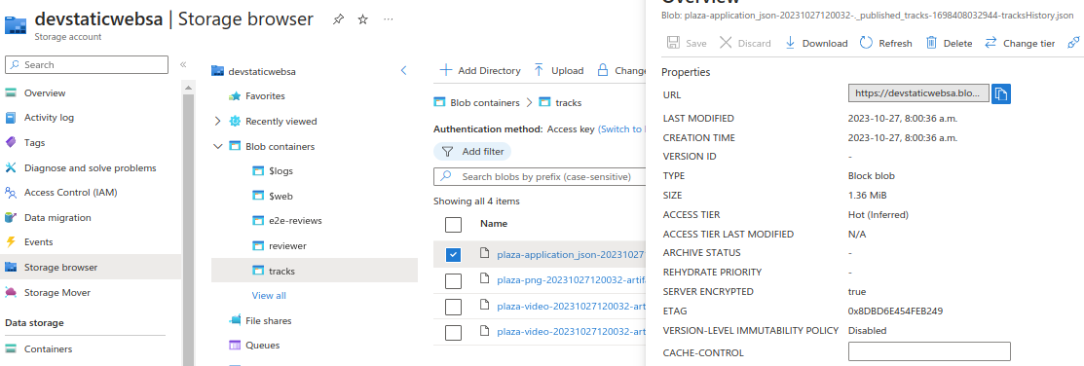
Review artifacts

Slide 4
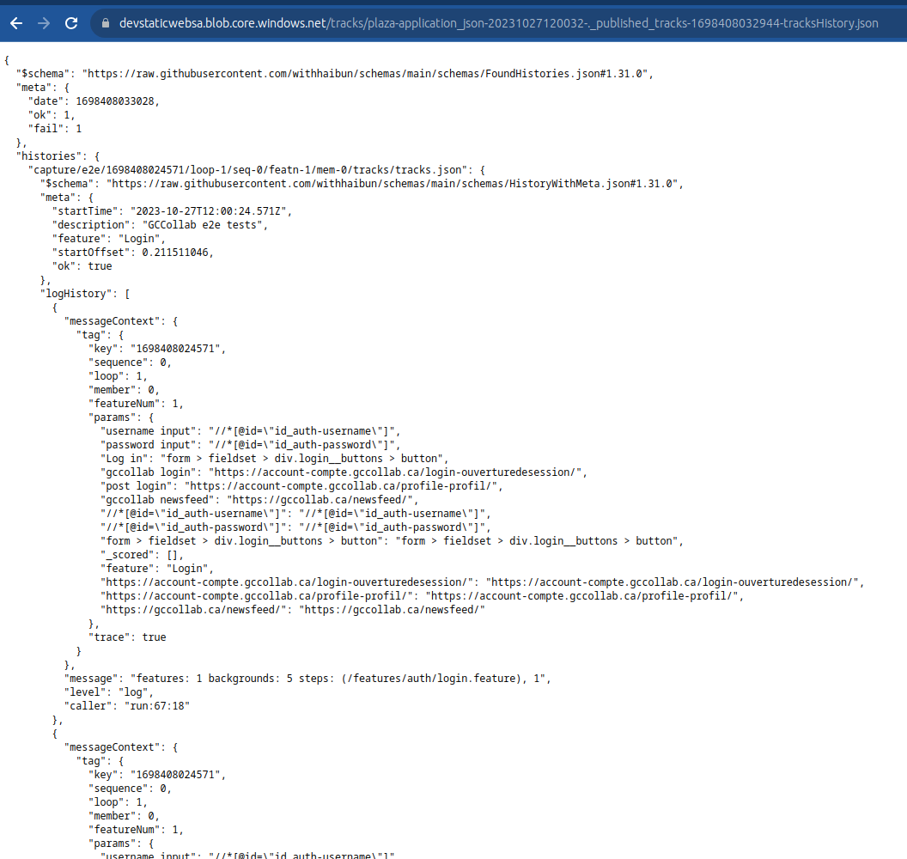
Review artifacts
.oO( How do we store schemas? )

Slide 5
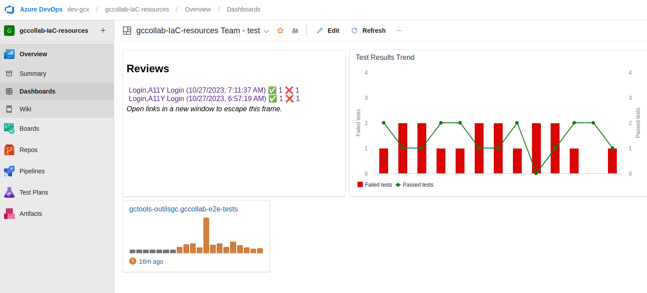
The dashboard
Results of latest reviews in dashboard widget, test results
https://dev.azure.com/dev-gcx/gccollab-IaC-resources/_dashboards/dashboard/7e455477-8503-439b-b0f4-014a87081ad6

Slide 6
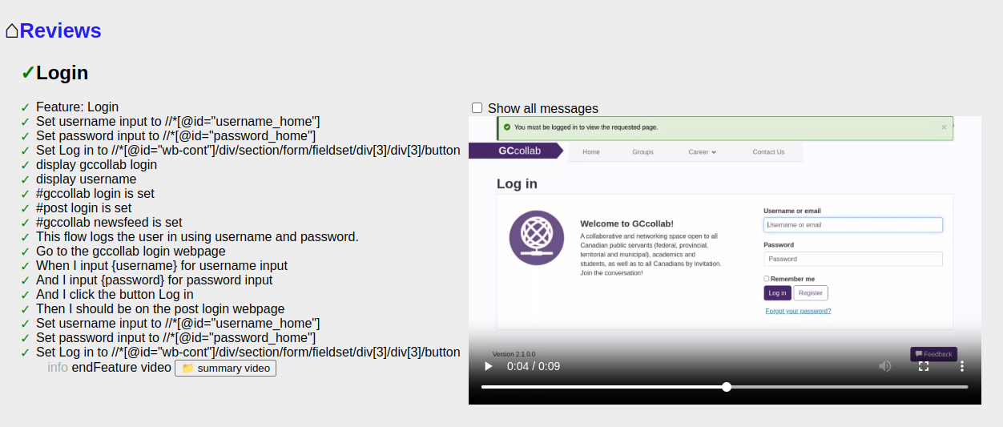
Review reports
Successful test

Slide 7
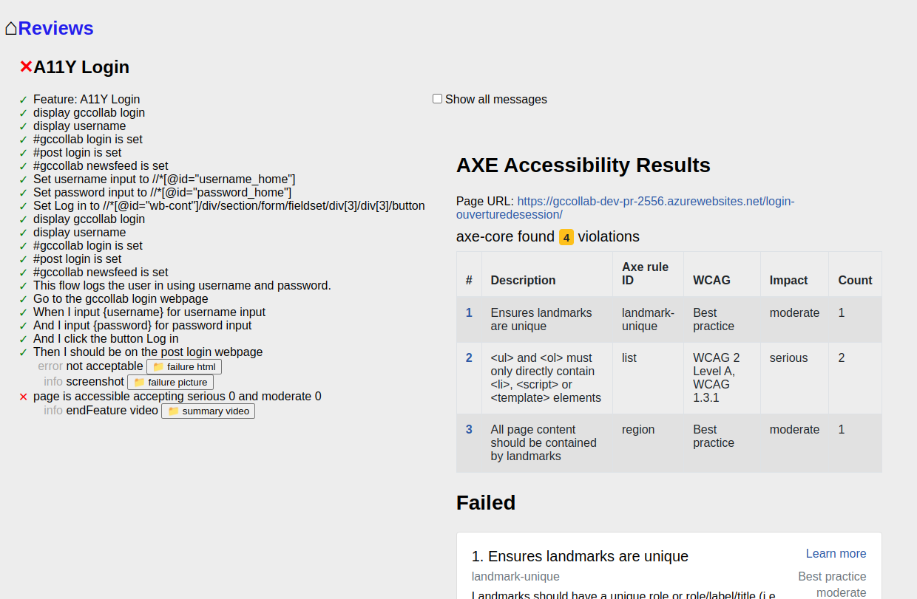
Review reports
Failing test, displaying report
Auto screen capture on failure

Slide 8
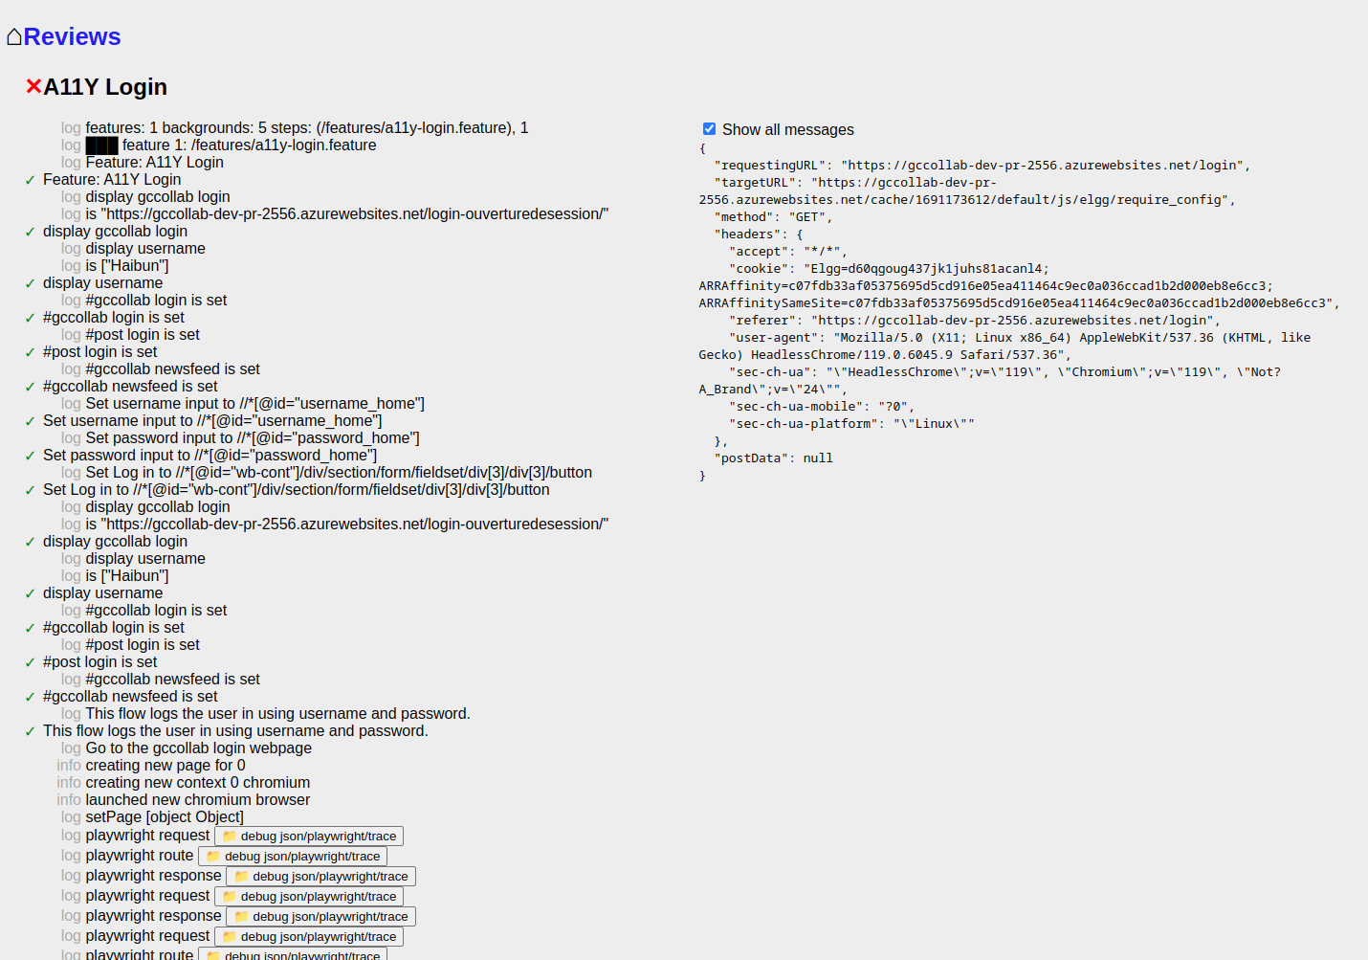
Review reports
Show all messages, traces

Slide 9
Using tests & reviews
During local development
With different deployments - local, staging, production, etc
In pipelines

Slide 10
More next steps
Gccollab legacy tests
Next gccollab tests
Load tests
GCExchange tests
Auto issues
- repo version + test name + step
Reusable bundled flows
Auto map
Compare reviews, references
Up to date documentation mapped to actual specification
Adapt to other clouds
Sustainability audit
Other audits

Slide 11
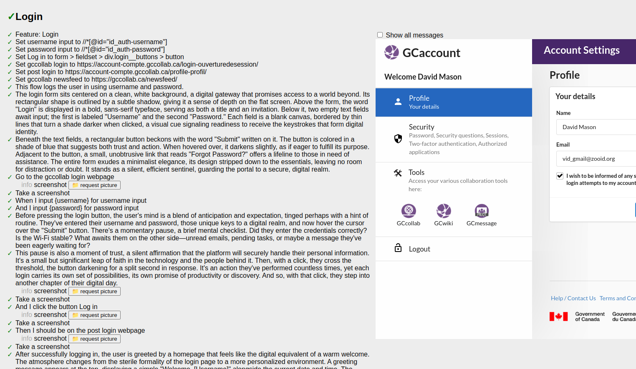
Example: Up to date documentation mapped to actual specification
With some formatting, use Haibun to generate documentation, always with the most up to date results based on specification

